Slide 1
Distributed Systems Design COMP 6231
Architectures
Lecture 2
Essam Mansour

Slide 2
Today…
Last Session:
Introduction
This Session:
Architectures for distributed systems (Chapter 2)
Architectural styles
Client-server architectures
Decentralized and peer-to-peer architectures

Slide 3
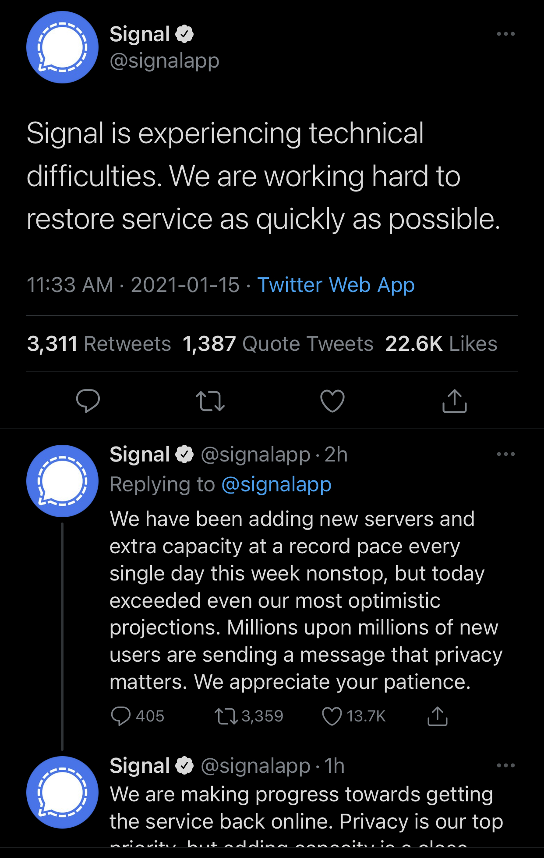

Slide 4

Bird’s Eye View of Some Distributed Systems
Peer 2
Google Server
Expedia
Peer 1
Peer 3
Request
Response
Reservation Client 1
Is it still the case ?
Search Client 1
Reservation Client 2
Search Client 2
Reservation Client 3
Search Client 3
Peer 4
Google Search
Bit-torrent
Airline Booking
Skype
How would one characterize these distributed systems?

Slide 5
Simple Characterization of Distributed Systems
What are the entities that are communicating in a DS?
Communicating entities (system-oriented vs. problem-oriented entities)
How do the entities communicate?
Communication paradigms (sockets and RPC)
What roles and responsibilities do the entities have?
This could lead to different organizations (referred, henceforth, to as architectures)

Slide 6
Architectural Styles
Important styles of architecture for distributed systems
Layered architectures
Object-based architectures
Data-centered architectures
Event-based architectures
Resource-based architectures

Slide 7
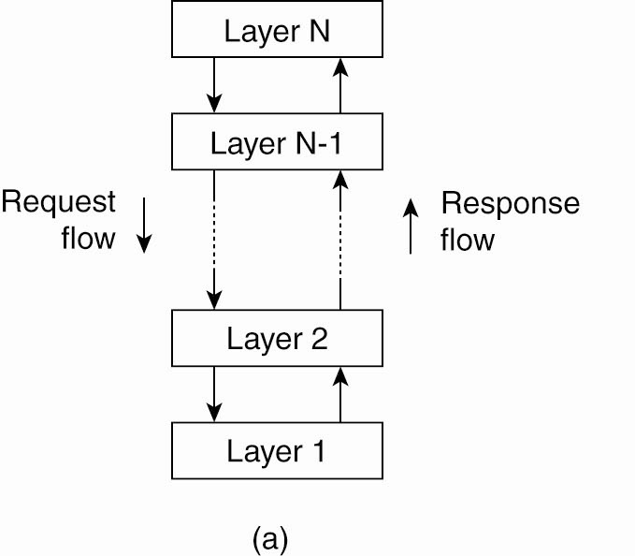
Layered Design
Each layer uses previous layer to implement new functionality that is exported to the layer above
Example: Multi-tier web apps

Slide 8
Layering
A complex system is partitioned into layers
Upper layer utilizes the services of the lower layer
A vertical organization of services
For example, a three-layer solution could easily be deployed on a single tier, such as a personal workstation.
Layering simplifies the design of complex distributed systems by hiding the complexity of below layers
Control flows from layer to layer
Layer 3
Request flow
Response flow
Layer 2
Layer 1

Slide 9
Layering – Platform and middleware
Distributed systems can be organized into three layers:
Platform
Low-level hardware and software layers
Provides common services for higher layers
Middleware
Masks heterogeneity and provides convenient programming models to application programmers
Typically, it simplifies application programming by abstracting communication mechanisms
Applications
Applications
Middleware
Operating system
Platform
Computer and network hardware

Slide 10
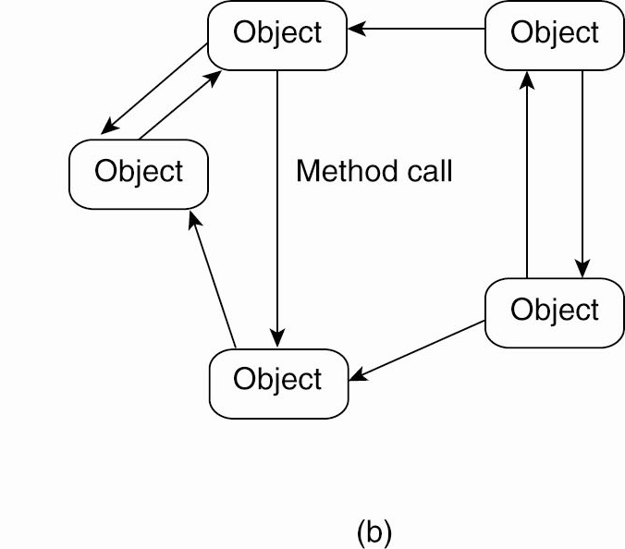
Object-based Style
Each object corresponds to a components
Components interact via remote procedure calls
Popular in client-server systems

Slide 11
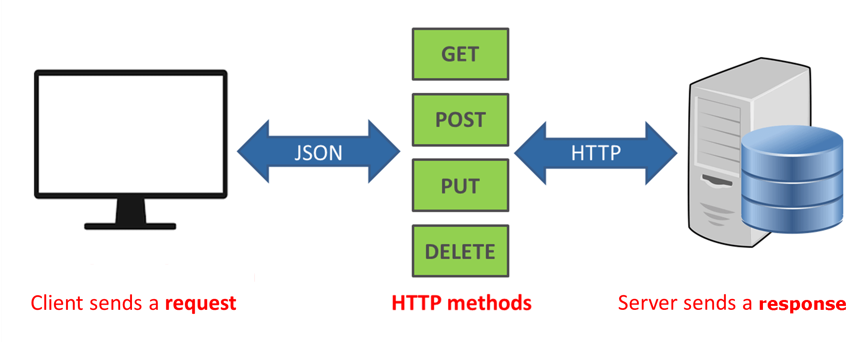
Resource-oriented Architecture
Example of ROA: Representational State Transfer (REST)

Slide 12
Resource-oriented Architecture
Example of ROA: Representational State Transfer (REST)
Basis for RESTful web services
Resources identified through a single naming scheme
Uniform Resource Identifier (URI)
All services offer same interface (e.g., 4 HTTP operations)
Get / Put / Delete / Post HTTP operations
Messages are fully described
No state of the caller is kept (stateless execution)
Example: use HTTP for API
http://bucketname.s3.aws.com/objName
Return JSON objects
{"name":"test.com","messages":["msg 1","msg 2","msg 3”],"age":100}
Discuss: Service-oriented (SOA) vs. Resource-oriented (ROA)

Slide 13
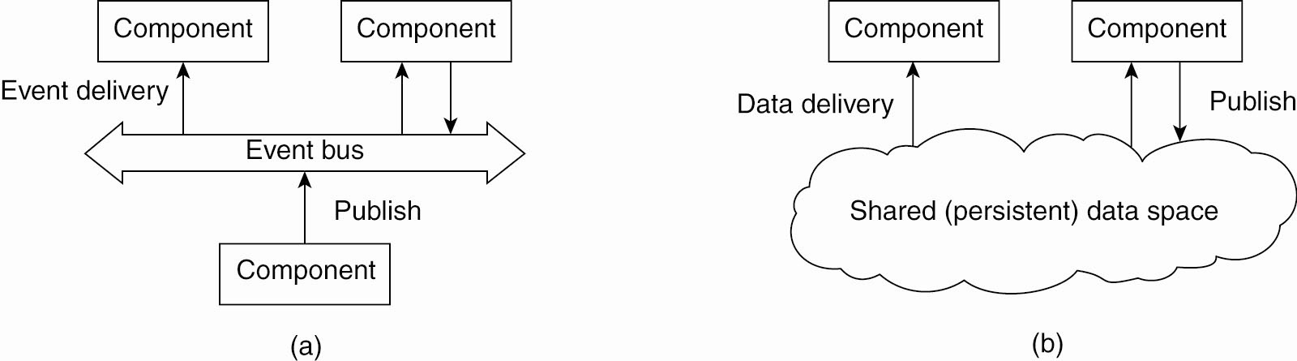
Event-based architecture
Communicate via a common repository
Use a publish-subscribe paradigm
Consumers subscribe to types of events
Events are delivered once published by any publisher

Slide 14
Shared data-space
“Bulletin-board” architecture
Decoupled in space and time
Post items to shared space; consumers pick up at a later time

Slide 15
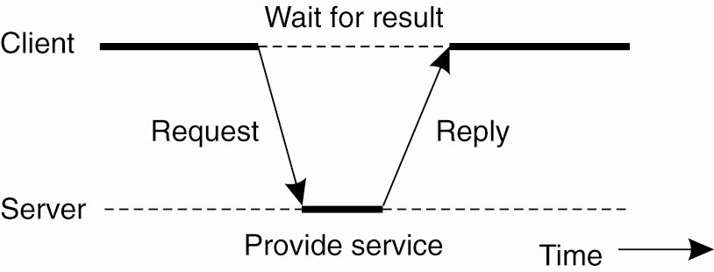
Client-Server Architectures
Most common style: client-server architecture
Application layering
User-interface level
Processing level
Data level

Slide 16
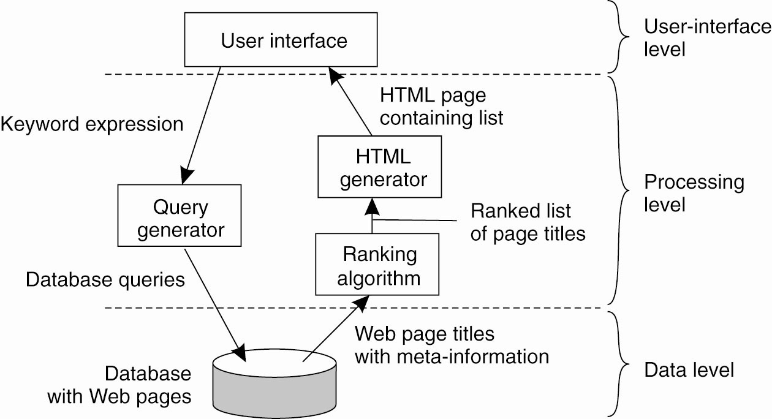
Search Engine Example
Search engine architecture with 3 layers

Slide 17
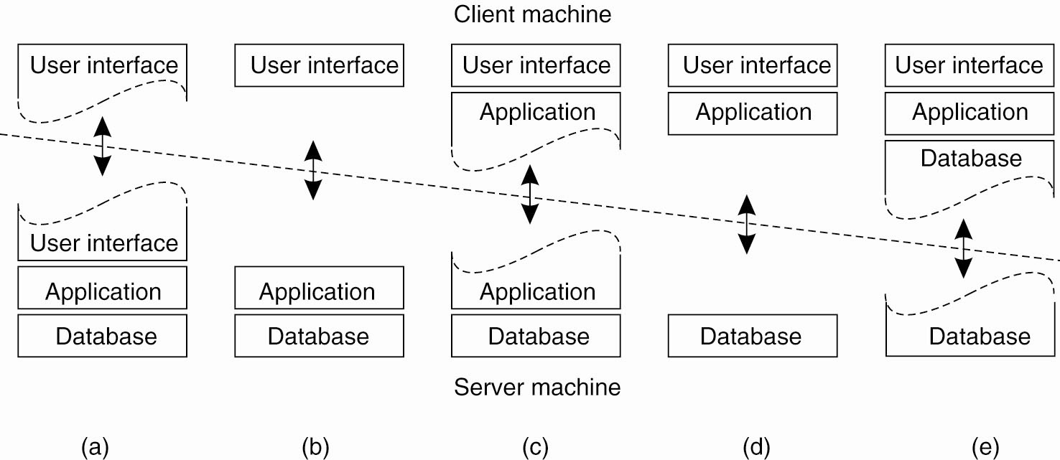
A Spectrum of Choices

Slide 18
Tiering
Tiering is a technique to:
Organize the functionality of a service,
and place the functionality into appropriate servers
a tier is a physical structuring mechanism for the system infrastructure
Airline Search Application
Display UI screen
Get user Input
Get data from database
Rank the offers

Slide 19
A Two-Tiered Architecture
How would you design an airline search application?
Tier 1
Tier 2
EXPEDIA Airline Search Application
Display user input screen
Get user Input
Airline Database
Display result to user
Rank the offers

Slide 20
A Three-Tiered Architecture
How would you design an airline search application?
Tier 1
Tier 2
Tier 3
EXPEDIA Airline Search Application
Display user input screen
Get user Input
Airline Database
Display result to user
Rank the offers

Slide 21
A Three-Tiered Architecture
Presentation Logic
Application Logic
Data Logic
User view, and controls
Application-Specific Processing
Database manager
User view, and control
Application-Specific Processing
Tier 1
Tier 2
Tier 3

Slide 22
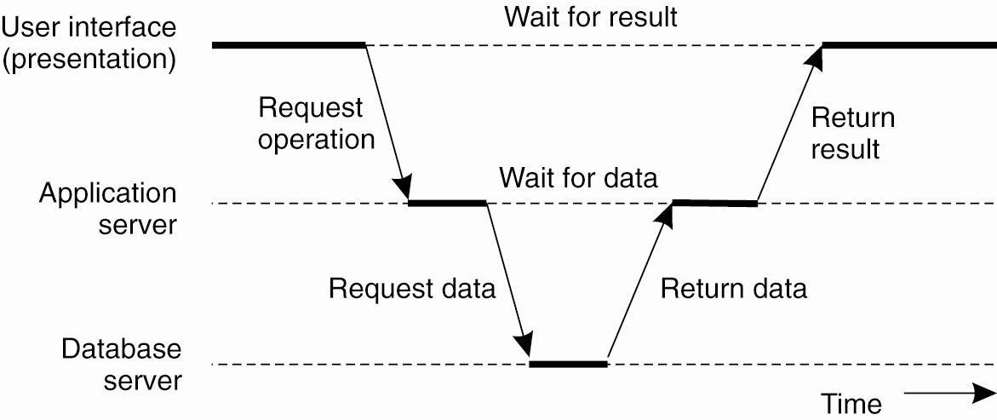
Three-tier Web Applications
Server itself uses a “client-server” architecture
3 tiers: HTTP, J2EE and database
Very common in most web-based applications

Slide 23
Three-Tiered Architecture: Pros and Cons
Advantages:
Enhanced maintainability of the software (one-to-one mapping from logical elements to physical servers)
Each tier has a well-defined role
Disadvantages:
Added complexity due to managing multiple servers
Added network traffic
Added latency

Slide 24
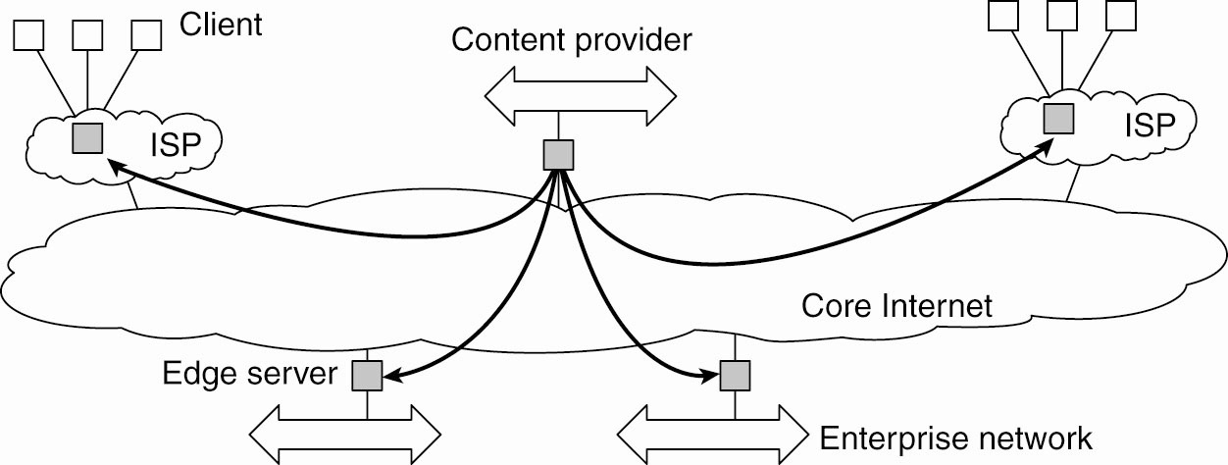
Edge-Server Systems
Edge servers: from client-server to client-proxy-server
Content distribution networks: proxies cache web content near the edge

Slide 25
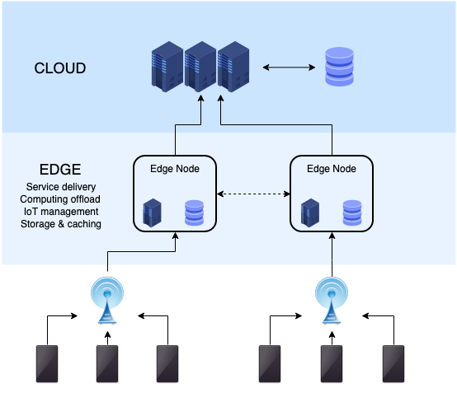
Edge-Server Systems
https://en.wikipedia.org/wiki/Edge_computing

Slide 26
Decentralized Peer-to-Peer Architecture
A peer-to-peer (P2P) architecture can be characterized as follows:
All nodes are equal (no hierarchy)
No Single-Point-of-Failure (SPOF)
A central coordinator is not needed
But, decision making becomes harder
The underlying system can scale out indefinitely
In principle, no performance bottleneck
Notes:
The architecture was popularized by the file sharing system Napster, originally released in 1999

Slide 27
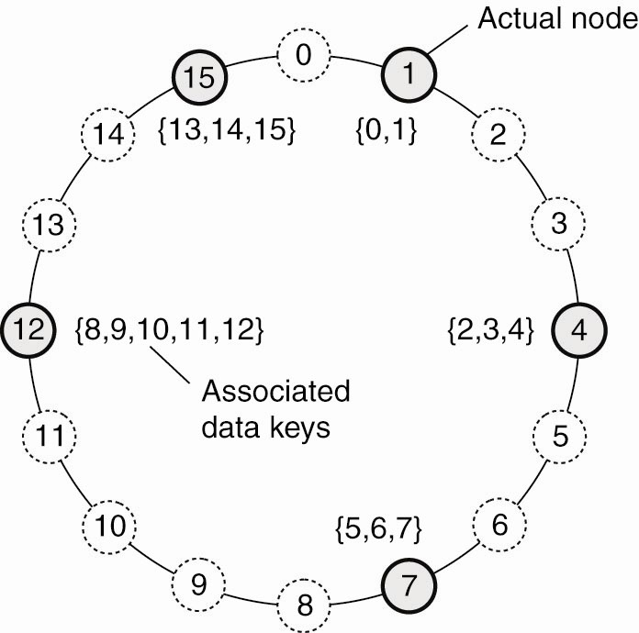
Decentralized Peer-to-Peer Architecture
Peer-to-peer systems
Removes distinction between a client and a server
Overlay network of nodes
Chord: structured peer-to-peer system
Use a distributed hash table to locate objects
Data item with key k -> smallest node with id >= k
Notes:
The architecture was popularized by the file sharing system Napster, originally released in 1999

Slide 28
Client-Server vs Peer-to-Peer
Notes:
The architecture was popularized by the file sharing system Napster, originally released in 1999

Slide 29
Peer-to-Peer Architecture
A peer-to-peer (P2P) architecture can be characterized as follows:
Peers can interact directly, forming groups and sharing contents (or offering services to each other)
At least one peer should share the data, and this peer should be accessible
Popular data will be highly available (it will be shared by many)
Unpopular data might eventually disappear and become unavailable (as more users/peers stop sharing them)
Peers can form a virtual overlay network on top of a physical network topology
Logical paths do not usually match physical paths (i.e., higher latency)
Each peer plays a role in routing traffic through the overlay network
Notes:
The architecture was popularized by the file sharing system Napster, originally released in 1999

Slide 30
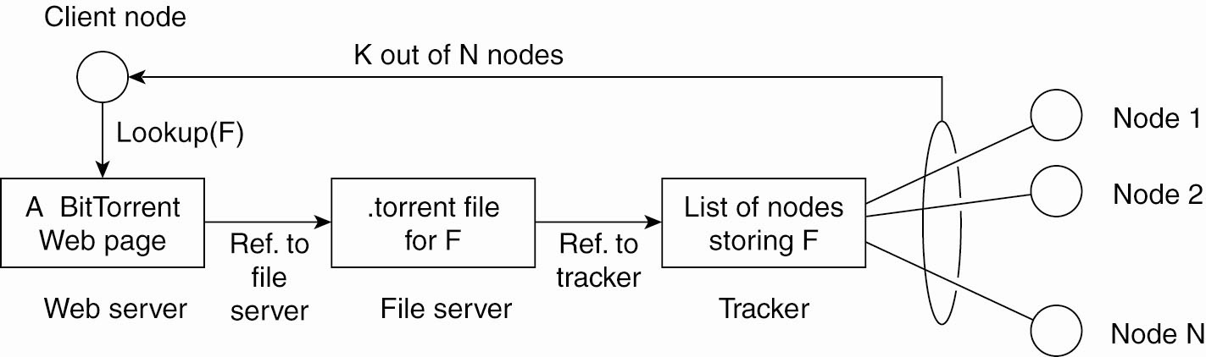
Peer-to-Peer Architecture
Collaborative Distributed Systems
BitTorrent: Collaborative P2P downloads
Download chunks of a file from multiple peers
Reassemble file after downloading
Use a global directory (web-site) and download a .torrent
.torrent contains info about the file
Tracker: server that maintains active nodes that have requested chunks
Force altruism:
If P sees Q downloads more than uploads, reduce rate of sending to Q
Notes:
The architecture was popularized by the file sharing system Napster, originally released in 1999

Slide 31
P2P Types
Types of P2P Architecture
Unstructured
Structured
Hybrid

Slide 32
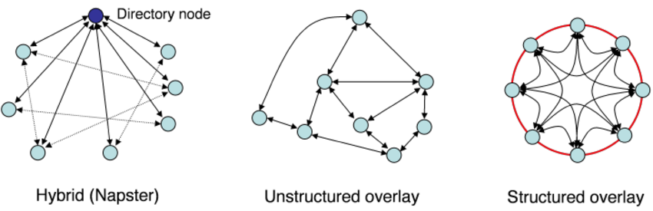
P2P Types

Slide 33
P2P Types
Unstructured P2P:
The architecture does not impose any particular structure on the overlay network
Each node pick a random set of nodes and becomes their neighbors
Choice of degree impacts network dynamics
Advantages:
Easy to build
Highly robust against high rates of churn (i.e., when a great deal of peers frequently join and leave the network)
Main disadvantage:
Peers and contents are loosely-coupled, creating a data location problem
Searching for data might require broadcasting

Slide 34
P2P Types
Types of P2P Architecture
Unstructured
Structured
Hybrid

Slide 35
P2P Types
Structured P2P:
The architecture imposes some structure on the overlay network topology
Main advantage:
Peers and contents are tightly-coupled (e.g., through hashing), simplifying data location
Disadvantages:
Harder to build
For optimized data location, peers must maintain extra metadata (e.g., lists of neighbors that satisfy specific criteria)
Less robust against high rates of churn

Slide 36
P2P Types
Types of P2P Architecture
Unstructured
Structured
Hybrid

Slide 37
P2P Types
Hybrid P2P:
The architecture can use some central servers to help peers locate each other
A combination of P2P and master-slave models
It offers a trade-off between the centralized functionality provided by the master-slave model and the node equality afforded by the pure P2P model
In other words, it combines the advantages of the master-slave and P2P models and precludes their disadvantages

Slide 38
Self-Managing Systems
System is adaptive
Monitors itself and takes action autonomously when needed
Autonomic computing, self-managing systems
Self-*: self-managing, self-healing
Example: automatic capacity provisioning
Vary capacity of a web server based on demand
Monitor
workload
Compute current/
future demand
Adjust allocation

Slide 39
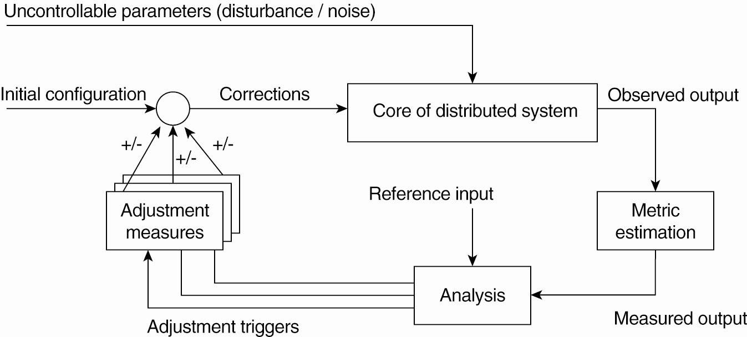
Feedback Control Model
Use feedback and control theory to design a self-managing system

Slide 40
A To-Do List
Read Chapters 2, Architectures
Project teams

